Slide 1
Digital Banking Transformation

Slide 2
Y&L Global Overview – Growing and Innovating with our Customers

Slide 3
Customer Centric Engagement Models – Flexible & Responsive
Engagement Maturity
Engagement
Maturity
YOU Specialist
Co-Innovation
Strategic Partnership
Right Shoring
Strategic
Model
Right
Shoring
Nearshore
Offshore
Onshore
Hybrid
Operating Model
Project Based
BOT
Factory Model
Managed Capacity
Managed Service
Outcome Linked
Customer
Sourcing
Ownership
Operating
Model
Insource / GIC
Outsource
Collaborative
Ownership
Offshore Development Center
Virtual Customer Center
Build Operate Transfer
Joint Venture
Sourcing
Strategic Model
Cloud Transformation
Cost Rationalization
Rebadging

Slide 4
Delivering Value & Innovation to our Banking Customers Locally and Globally
Some Banking Customers

Slide 5
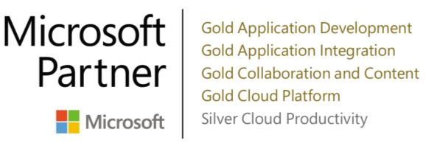
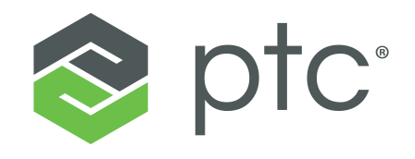
Strategic Partnerships Fostering Customer Success

Slide 6
Digital Transformation Expertise

Slide 7
What do we do?
GRC
DX =
CX
OX
Helping Banks Achieve Sustainable Growth, using Digital Transformation (DX), delivering Customer Experience (CX) and Operational Excellence (OX), empowered by Governance, Risk and Control.

Slide 8
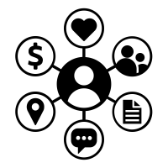
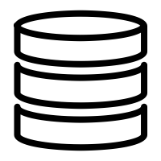
Using Digital Transformation to deliver CX, OX & GRC
Social
Mobility
Cloud
Big Data
IoT
Customer Experience
Operational Excellence
UX, Omni-Channel, Engagement
Analytics
BPM, ERP, RPA
AI/ML
Governance, Risk and Controls

Slide 9
Y&L Digital Banking Transformation Partners
Customer
Experience (CX)
Retail Banking
Capital Markets
Corporate Banking
Operational
Excellence (OX)
Core Banking
Cards & Payments
Lending
Investment Banking
M&A
Trade Finance
Liquidity
Commercial Lending
Governance, Risk
& Controls (GRC)
Wealth Management / Investment Management
Regulatory Reporting
Digital
Transformation (DX)
Risk monitoring & Control

Slide 10
Y&L Banking Industry Digital Transformation Offerings
Envision
Empower
Execute
Design Thinking
CRM & Social Analytics
Agile Consulting
MS Dynamics & Salesforce
Hadoop, Casandra
Tensorflow, Spark
Python, Scala, R
Angular JS
React JS
IOS, Android
Xamarin
Omni Channel Banking
Customer Journey Mapping
Digital & Social Strategy
Customer
Experience (CX)
New Banking Business Models
Banking Processes Transformation
Automation Strategy
Banking Applications Portfolio Rationalization
Architectural Consulting
Technology Process Transformation
DevOps consulting
Legacy Modernization
Cloud consulting
Corda, Hyperledger, Ethereum
Automation Anywhere
BluePrism, UIPath
OpenSpan, Workfusion
SAP, Pega, MS Dynamics
Calypso, Murex
GMI/Clearvision, Summit
Azure, AWS
Selenium, HP QTP
JMeter, HP LoadRunner
Mainframe/AS 400
Java, JavaEE, Spring
.NET, ASP. NET
SQL Server
Oracle
MongoDB
DB2
Infra Mgmt. & Support
Operational
Excellence (OX)
Governance, Risk
& Controls (GRC)
Digital Banking Assessment
DX Roadmap
Governance Advisory
Communication Strategy
Reg Reporting
Compliance Analytics
Risk Dashboards
KRI Monitoring
PMO
Tableau, QlikView
Info Sec
SOC/NOC
Collaboration Platforms
Digital
Transformation (DX)

Slide 11
Thank you.

